Slide 1
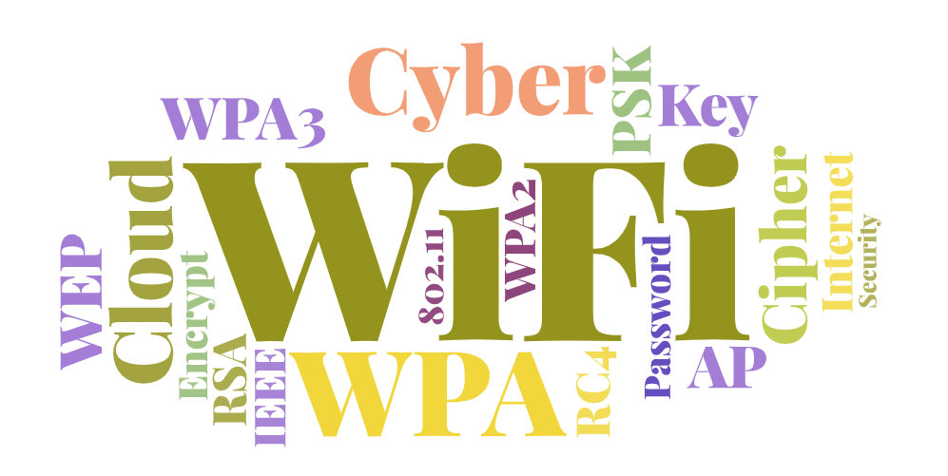

今晚的WiFi有點喧囂
有關WiFi加密協定的兩三事
By 游庭瑋 廖柏丞

Slide 2
Table of contents
IEEE 802.11 Encrypt Protocol
WEP encryption
Demo

Slide 3

Intro of IEEE 802.11 Encrypt Protocol

Slide 4
Security Protocols for IEEE 802.11
WEP (Wired Equivalent Privacy, deprecated in 2003) The most insecure encryption
2. WPA / WPA2 / WPA3
3. WPA-PSK / WPA2-PSK (popular)

Slide 5

The mechanism in WEP
40-bit symmetric key ($K_{s}$)
24-bit Initialization Vector (IV) + 40-bit $K_{s}$
= 64-bit key
64-bit key can generate keystream by RC4
AP uses key stream to encrypt data. Wireless host uses key stream to decrypt data, vice versa.

Slide 6
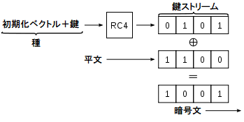
The mechanism in WEP

Slide 7
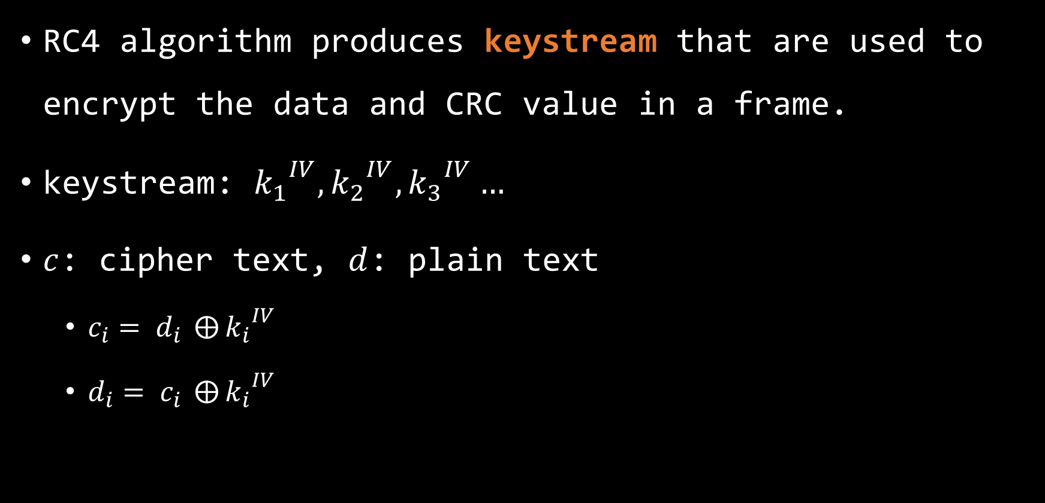
What is RC4?
RC4 algorithm produces keystream that are used to encrypt the data and CRC value in a frame.
keystream: ${k_{1}}^{IV},{k_{2}}^{IV},{k_{3}}^{IV}…$
$c$: cipher text, $d$: plain text
$c_{i}= d_{i} ⨁{{k_{i}}^{IV}}$
$d_{i}= c_{i} ⨁{{k_{i}}^{IV}}$

Slide 8
Problems
RC4 algorithm requires that the same key value never be used more than once.
Otherwise, it could be cracked.

Slide 9
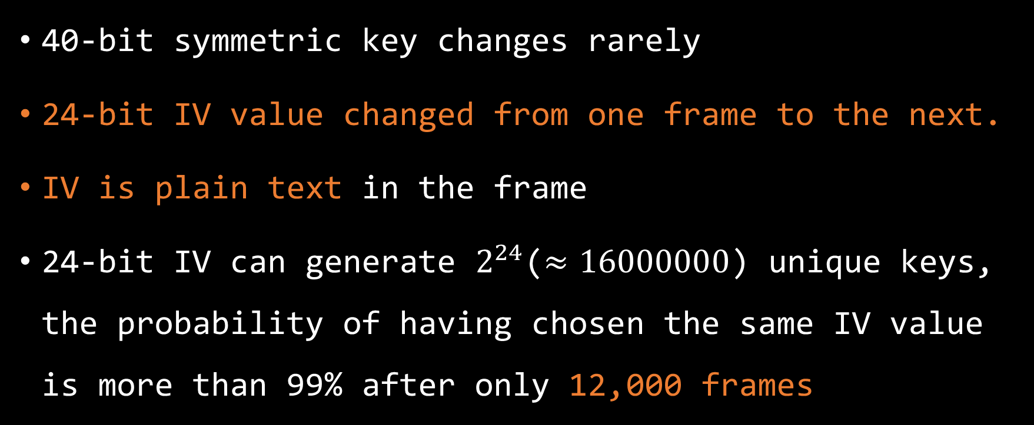
Problems
40-bit symmetric key changes rarely
24-bit IV value changed from one frame to the next.
IV is plain text in the frame
24-bit IV can generate $2^{24}$($≈16000000$) unique keys, the probability of having chosen the same IV value is more than 99% after only 12,000 frames

Slide 10

Moreover…
Recall that: $d_{i}= c_{i}⊕{k_{i}}^{IV}$
Magic happened:
$$d_{i} ⊕ c_{i}=\left(c_{i} ⊕ {k_{i}}^{IV}\right) ⊕c_{i}$$
$$d_{i} ⊕ c_{i}={k_{i}}^{IV}$$

Slide 11

Moreover…
If anybody sends/receives frames to/from AP, and the IV in the frame has appeared in the past, Trudy can get ${K_{i}}^{IV}$
When Trudy knows ${K_{i}}^{IV}$, she or he knows plain text because: $d_{i}= c_{i}⊕{k_{i}}^{IV}$

Slide 12



Consider that…
Spoofing
Got frames
Spoofing
Notes:
Trudy sends a numerous of requests and get a numerous of frames from AP
Trudy knows c (encrypted data), d (plain text)
Trudy can calculate ${K_{i}}^{IV}$

Slide 13
Moreover…
NOTE: ARP request will force AP to change IVs
Got a lot of frames and different IVs!
ARP request replay
(broadcast)
ARP request
ARP request replay
(broadcast)

Slide 14
Cracking WEP encryption
Warning: Do not try to crack AP that is not yours. It can be illegal.

Slide 15
Lab
Environments:
Kali Linux with aircrack-ng tools
WiFi Router
A connected device(iPad)
WiFi Router Setting:
WEP(128 bits = 104 bits key + 24 bits IV)
Open system
key: 12345678abcde

Slide 16
Steps
By aircrack-ng official documents, following is the step to crack an WiFi station with WEP encryption:
Start the wireless interface in monitor mode
Test the injection capability(skipped)
Use aireplay-ng to do a fake authentication with the access point

Slide 17
Steps
Start airodump-ng on AP channel to collect the new unique IVs
Start aireplay-ng in ARP request replay mode to inject packets
Run aircrack-ng to crack key using the IVs collected

Slide 18
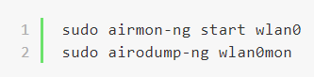
Step 1
Open monitor mode and search bssid

Slide 19
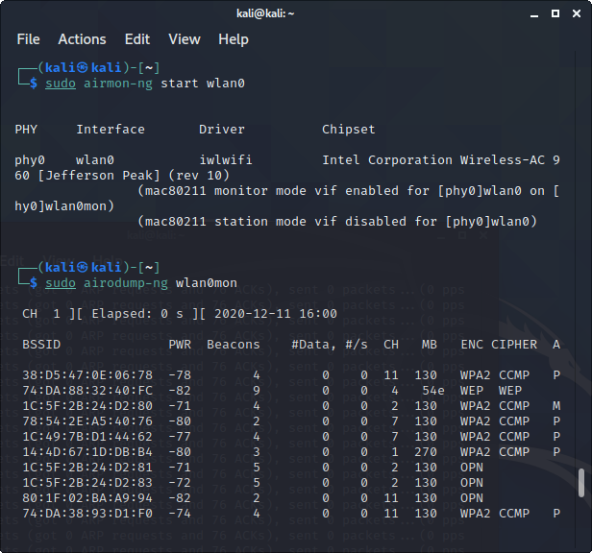

Slide 20
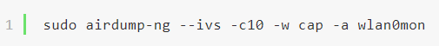
Step 2
Select the AP, and start to record frames

Slide 21
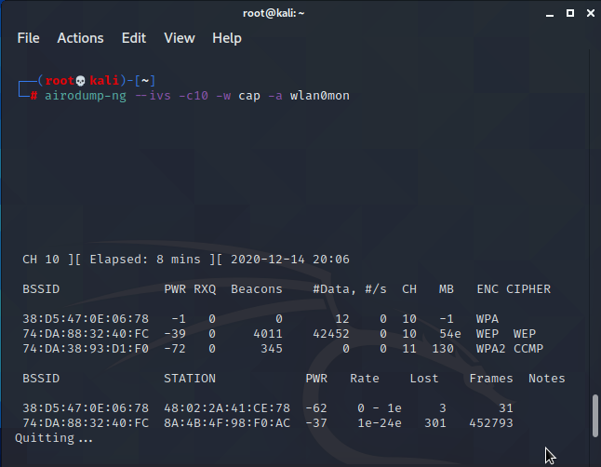

Slide 22
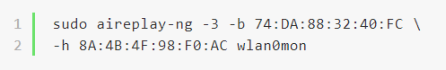

Step 3
Start ARP request injection, Calculate ${k_{i}}^{IV}$and record
Notes:
表示使用aireplay-ng的第三种攻击模式，ARP-request 注入攻击模式，当抓取到一个ARP请求包的时候对它进行重放,WEP体系的AP会对重放的ARP请求包进行应答。当AP存在合法的客户端连接的时候，少量数据就可产生有效的ARP-request；如果没有合法客户端与AP相连，就无法得到ARP-request，则这种攻击方式就会失败。

Slide 23
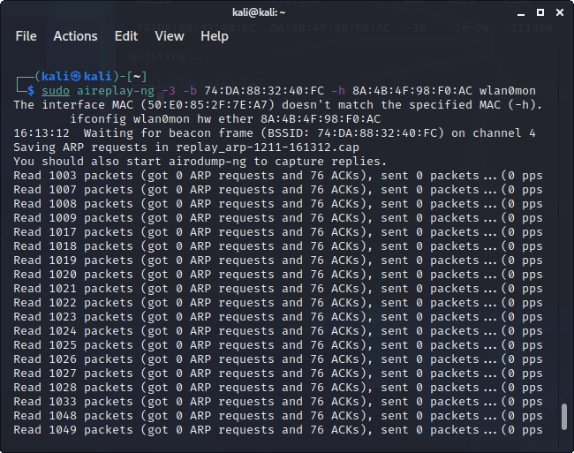

Slide 24
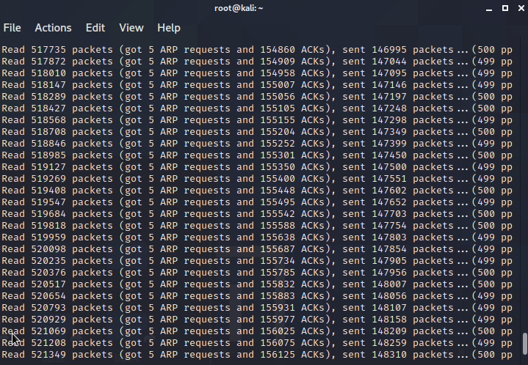

Slide 25
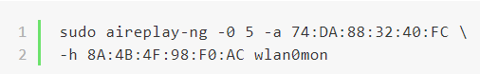
Step 4
Optional
Create fake disassociate frame
Notes:
Deautenticate 冲突模式，伪造一个disassocate包,让客户端与AP失去连接，之后客户端会重新连接AP（说直白点就是把你连接到wifi的手机、电脑之类的打掉线，然后这些设备会自动去重新连接WIFI）,通过重新连接过程我们可以获取到ARP数据包

Slide 26
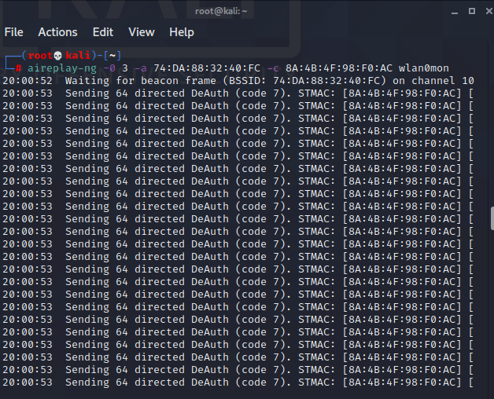

Slide 27
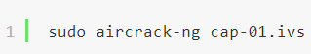
Step 5
waiting for enough frame, try to crack password

Slide 28
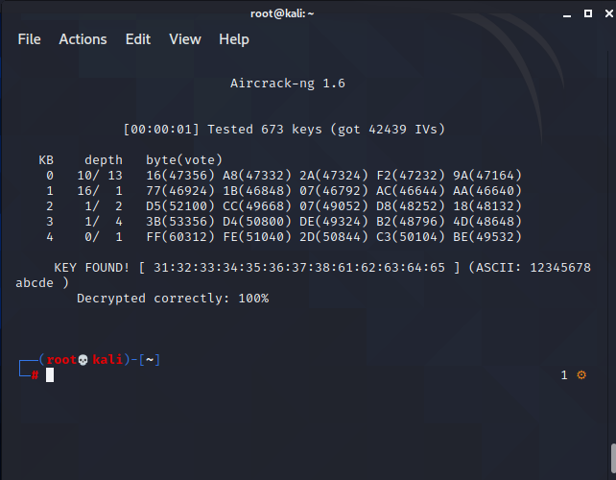

Slide 29
Lab conclusion
About 10 minutes can crack an AP with WEP encryption
Regardless how complicate the password is
With Step 4, we can get ARP request faster
When operating, network speed goes down significantly

Slide 30
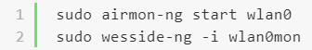
Sound complicated?
wesside-ng is an even more simple tools, all you needs is to type:
Done!
It will search all APs can attack, then crack them!

Slide 31
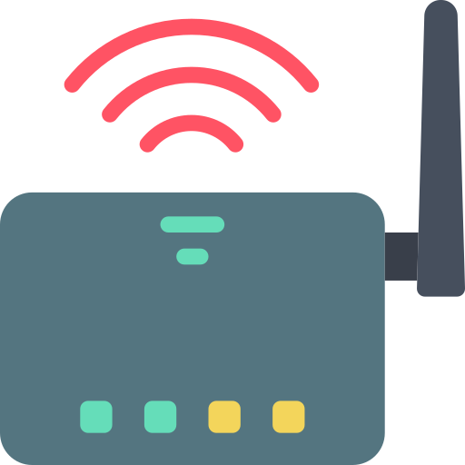
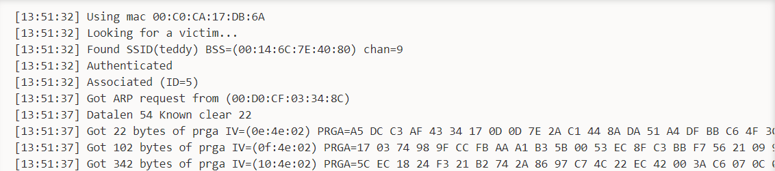
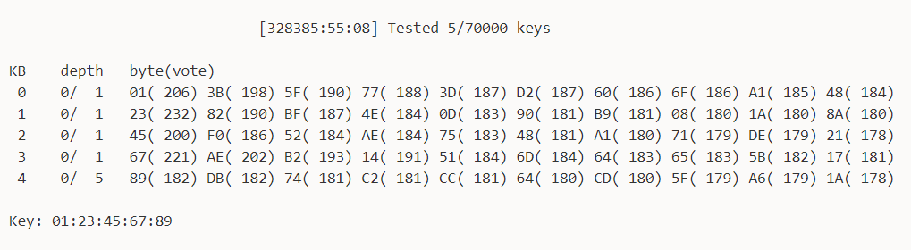
Record of wesside-ng
...Skip...

Slide 32
When you connecting to the insecure WiFi
You may suffer…
Someone stealing your data, by ARP spoofing
Or just get WiFi password and reveal the data flow in the air
When speed goes down apparently, you may have been under attacked.

Slide 33
Conclusion
Do not use WEP, change to WPA/WPA2-PSK for higher security
If you need to connect to public WiFi, notice that
Is the source of WiFi safe?
Does it use WPA/WPA2 with password?
If not necessary, just use mobile network(4G/5G) instead
Don’t trust anyone on network!!

Slide 34







Reference
Wesside-ng
破解無線網路WEP加密，
已經不需要專業
Kali破解家用WI-FI密码 - WEP加密
RC4-維基百科，
自由的百科全書
Tutorial: Simple WEP Crack
Icons made by
Freepik and smashicons from www.flaticon.com
ARP request replay attack

